Slide 1
Opinion Mining
Ayan Karim

Slide 2


Business Problem
Any company that sells a product in mass production generates a huge amount of public opinion on the product and tons of reviews, articles, reactions and overall sentiments are posted online, especially soon after release.
As of 2017, 223 million iPhones were sold in the US (CITE) which is huge considering the population was 325 million (this information was from 2017)!
How do companies access this data from the public media and turn it into something useful? How do we extract all that diverse information from the web and analyze it??

Slide 3
Let’s Pretend We’re Apple!
What does Public Opinion tell us about the iPhone X?
What are some negative aspects of the iPhone X that people dislike about our product?
How does our product compare with that of a competing smartphone like the Samsung Galaxy S9?

Slide 4
Introduction
What is Opinion Mining?
What is Aspect-Based Sentiment Analysis

Slide 5
Pipeline
1. Scrape text data from the web
2. Process our texts
3. Latent Dirichlet Allocation to extract and assign topics
4. ML classifiers trained on text data to classify Topics
5. Model text to Extract Sentiments and Aspects
6. Assign aspects and sentiments to topics
7. Matplotlib and Seaborn to Visualize results

Slide 6
Technology
1. Scrapy to scrape data
2. NLTK, Spacy and Gensim process texts
3. Gensim's Latent Dirichlet Allocation to extract and assign topics
4. pyLDAvis for visualization
5. Scikit Learn, Multi-Label Naive Bayes and Support Vector Machines to train text data on Topics
6. Scikit Multilearn, PowerLabelset to train on multiple labels
7. Spacy Dependency Parser, Countvectorizer and TF-IDF vectorizer for Aspect-Based Semantic Analysis
8. Word2Vec pre-trained on Google's News dataset for assigning aspects and sentiments to topics
9. Matplotlib and Seaborn for data visualization

Slide 7
Pre-trained and Other Datasets
1. Opinion Lexicon by Minqinq Hu and Bing Liu
2. Word2Vec pre-trained on Google's News dataset for assigning aspects and sentiments to topics
3. WordSim353 to Evaluate Word2Vec model

Slide 8



Part 1: Topic Modeling

Slide 9
digitaltrends.com gizmodo.com techradar.com
1. iPhone X
2. Galaxy S9
3. Pixel 3
4. Huawei Mate 20 Pro
5. OnePlus 6T
6. Huawei P2 Pro
7. LG V4 Thinq
8. Sony Xperia XZ3
9. Essential Phone
10. Razer Phone 2
11. HTC U12+
12. Moto G6 plus

Slide 10
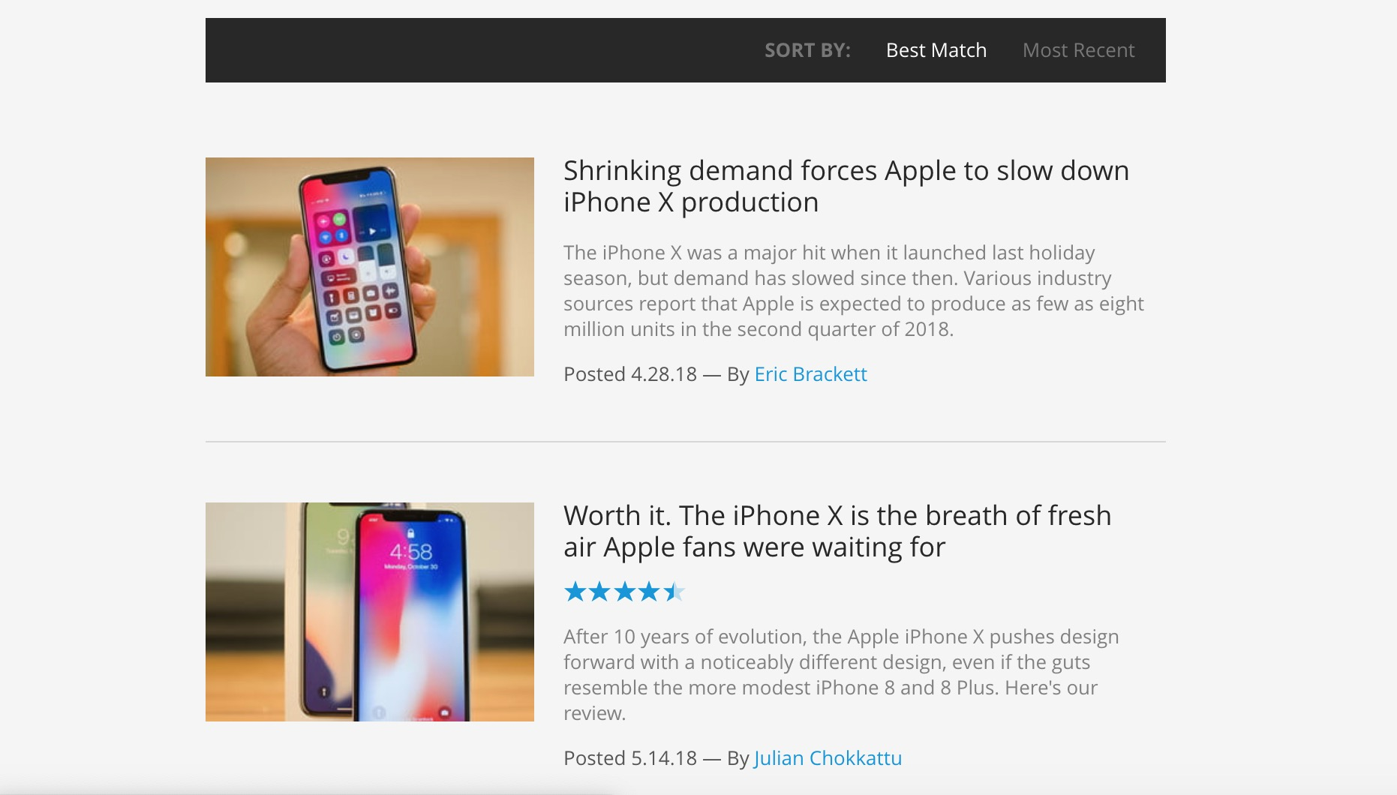

Slide 11
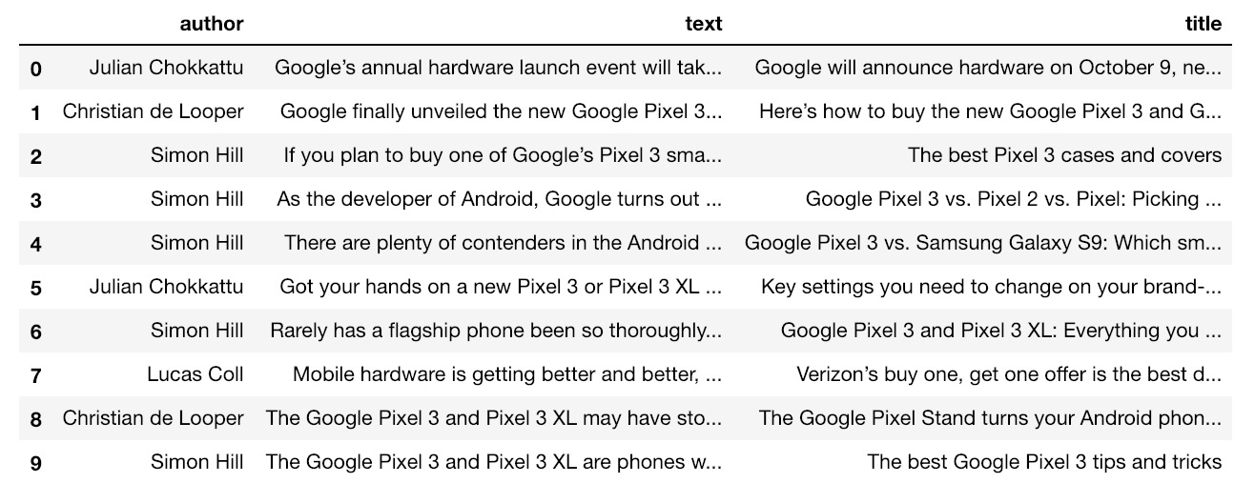

Slide 12
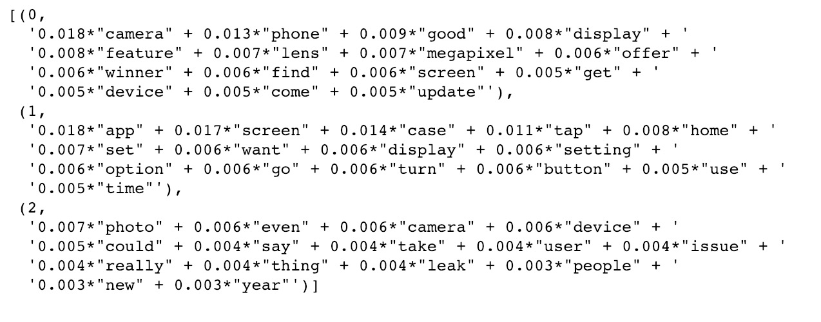
LDA

Slide 13
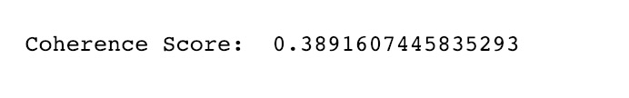
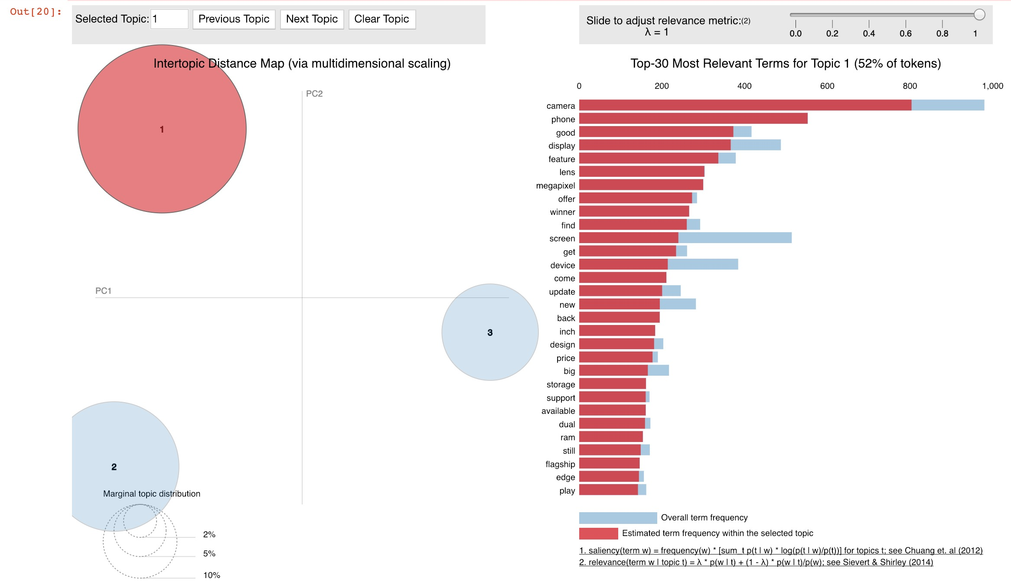
Coherence and pyLDAvis

Slide 14
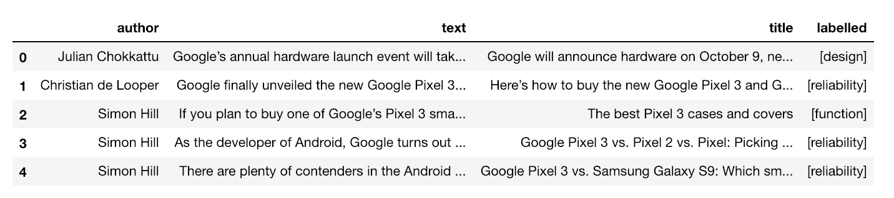
Assign Labels

Slide 15
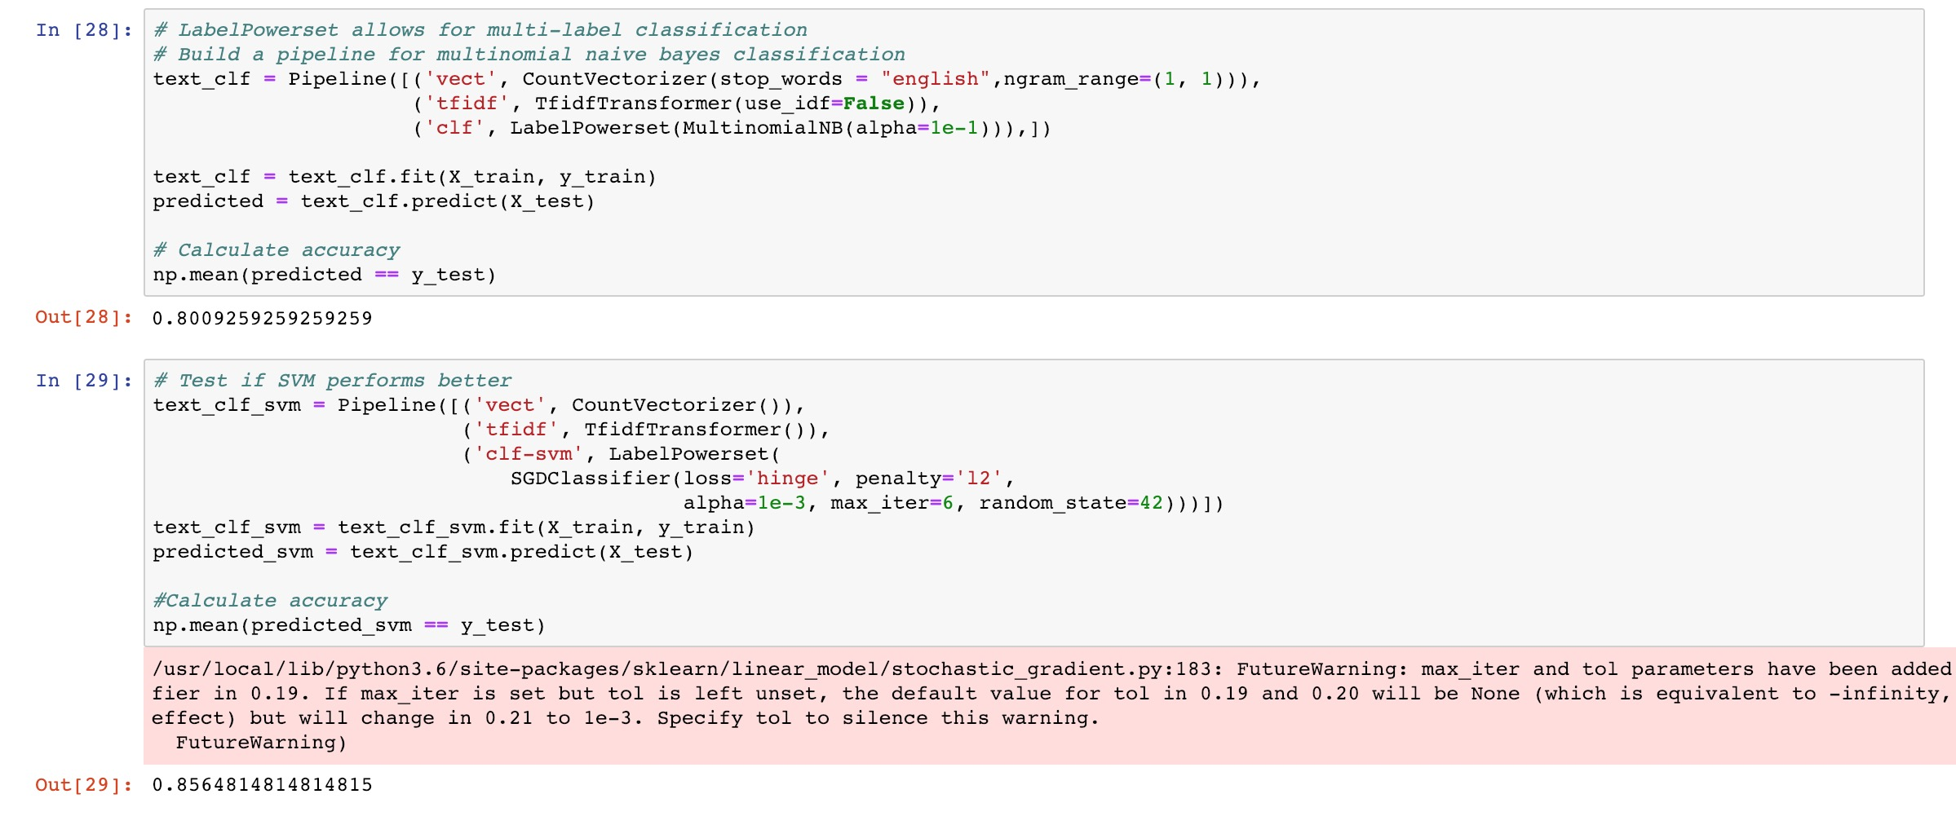
Multi-Label Classifier

Slide 16
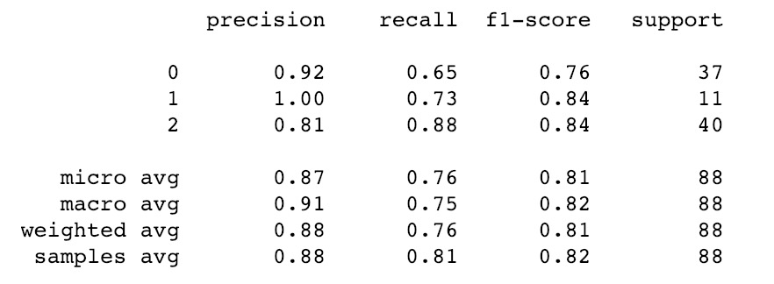
SVM Multi-Label Classifier

Slide 17
Part 2: Aspect-Based Sentiment Analysis

Slide 18
digitaltrends.com gizmodo.com techradar.com
1. iPhone X
2. Galaxy S9

Slide 19
Aspect-Based Sent. Analysis Pipeline
Extract
Extract Aspect and Sentiment.
“The screen is ugly”
“The apps are smooth”
Classify
Classify Terms and Sentiments into Topics.
{Design: {“screen”: -1}, Function: {“buttons”: 1}}
Visualize
Visualize Topics, Aspects and Sentiments.

Slide 20
Extract Aspect and Sentiment

Slide 21
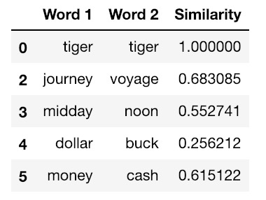
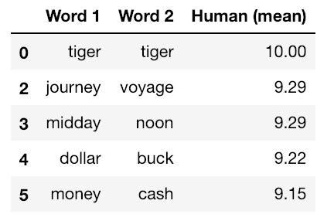

Evaluating Word2Vec using WordSim353 Data Base

Slide 22
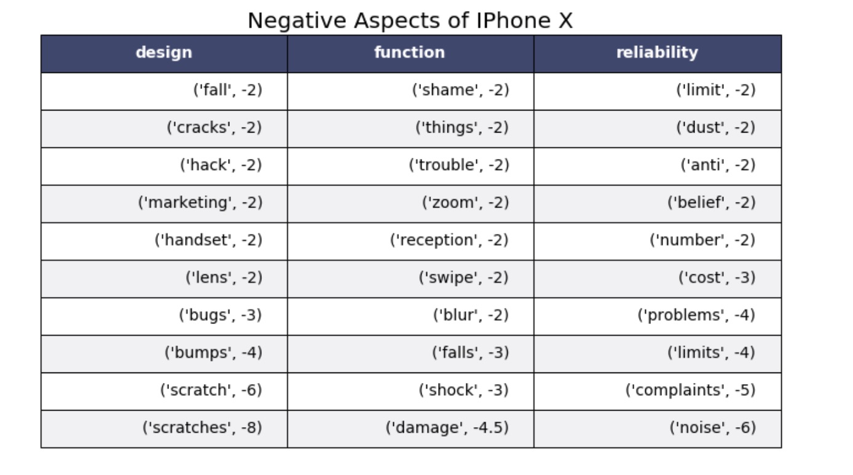
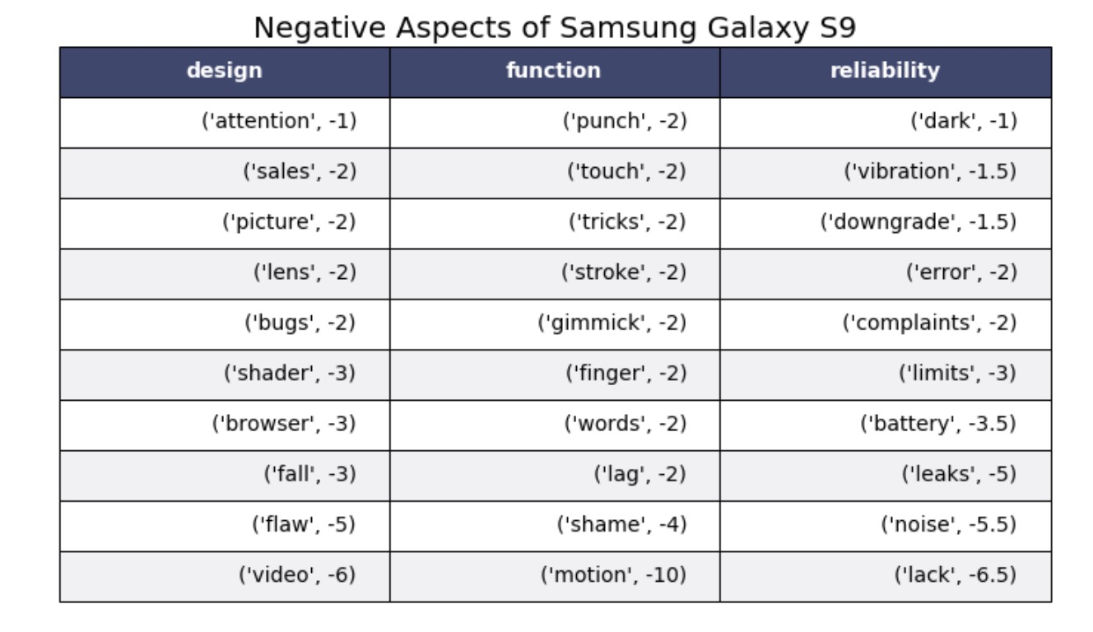
Visualize Topics, Aspects and Sentiments.

Slide 23
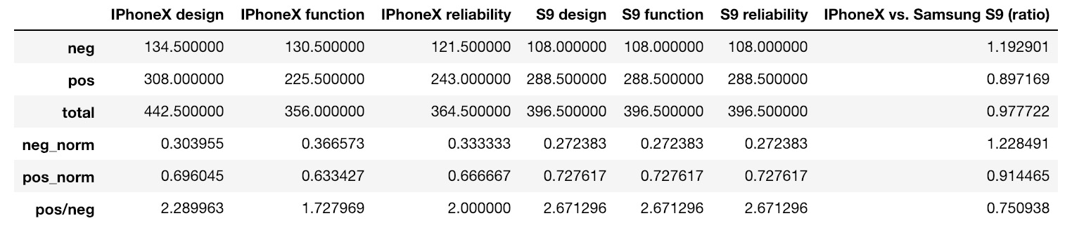
iPhone X vs. Samsung Galaxy S9

Slide 24
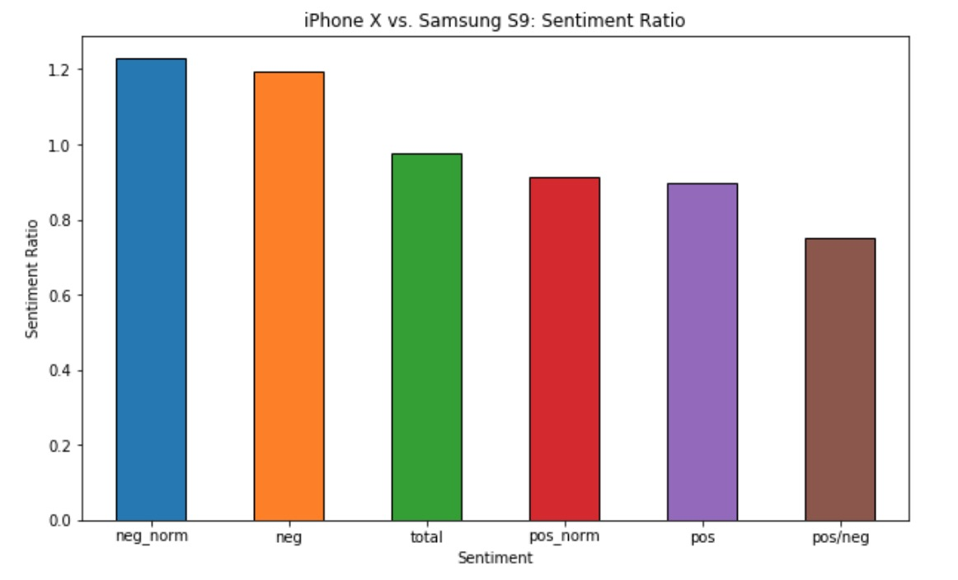
iPhone X vs. Samsung Galaxy S9

Slide 25
Conclusions

Slide 26
Improvements and Next Steps
1. Scrape more Data to improve the quality of topic model.
2.

Slide 27
Work Cited

